Slide 1
Air Pollution, Acid Rain, Smog and Green House Effect

Slide 2
What is the Nature of the Atmosphere?
The two innermost layers of the atmosphere are the troposphere, which supports life, and the stratosphere, which contains the protective ozone layer.

Slide 3
Earth’s Atmosphere
Troposphere
5-11 miles above earth’s surface
75–80% earth’s air mass
78% N₂, 21% O₂
Weather and climate
Stratosphere
Ozone layer

Slide 4
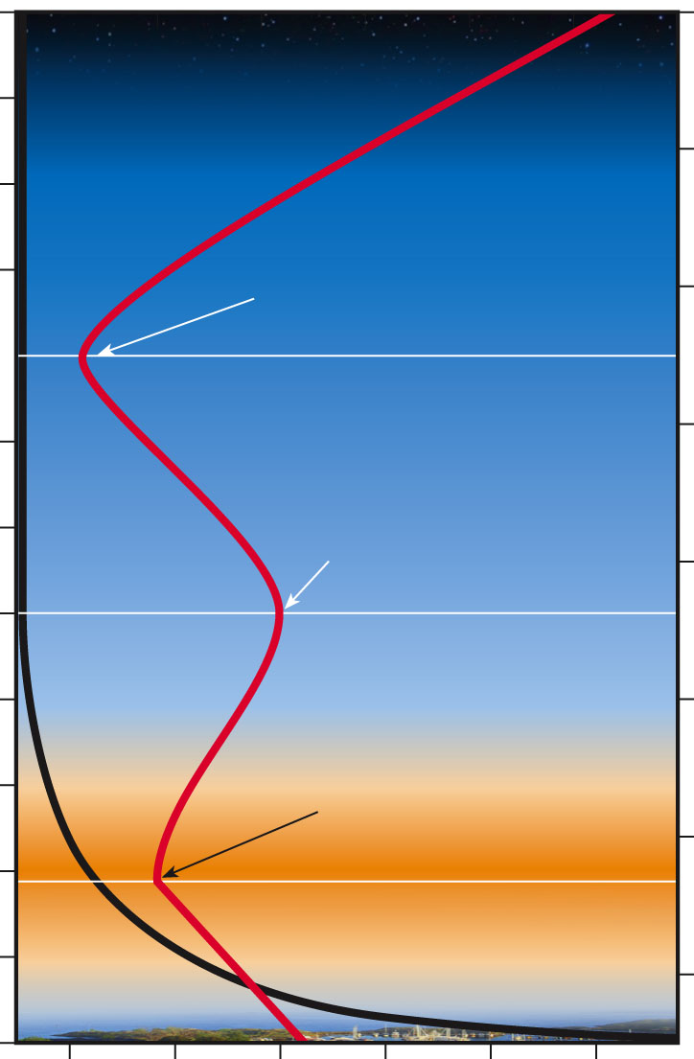
Atmospheric pressure (millibars)
75
65
55
45
35
25
15
5
120
110
100
90
80
70
60
50
40
30
20
10
0
0 200 400 600 800 1,000
Temperature
Thermosphere
Mesopause
Mesosphere
Altitude (kilometers)
Altitude (miles)
Stratopause
Stratosphere
Tropopause
Ozone layer
Pressure
Troposphere
(Sea
Level)
Pressure =
1,000
Millibars at
ground level
–80 –40 0 40 80 120
Temperature (°C)
Fig. 15-2, p. 370
Notes:
Figure 15.2: Natural capital: The earth’s atmosphere is a dynamic system that includes four layers. The average temperature of the
atmosphere varies with altitude (red line) and with differences in the absorption of incoming solar energy. Most ultraviolet radiation from
the sun is absorbed by ozone, found primarily in the stratosphere in the ozone layer 17–26 kilometers (11–16 miles) above sea level.
Question: What would happen to life as we know it if the ozone layer in the stratosphere disappeared? Explain.

Slide 5
What Are the Major Air Pollution Problems?
Concept (Out Door )
Three major outdoor air pollution problems are industrial smog from burning coal, photochemical smog from motor vehicle and industrial emissions, and acid deposition from coal burning and motor vehicle exhaust.

Slide 6
What Are the Major Air Pollution Problems?
Concept (Indoor)
The most threatening indoor air pollutants are smoke and soot from wood and coal fires (mostly in developing countries) and chemicals used in building materials and products.

Slide 7
Outdoor Air Pollution
What is air pollution?
Stationary and mobile sources
Primary pollutants
Secondary pollutants

Slide 8
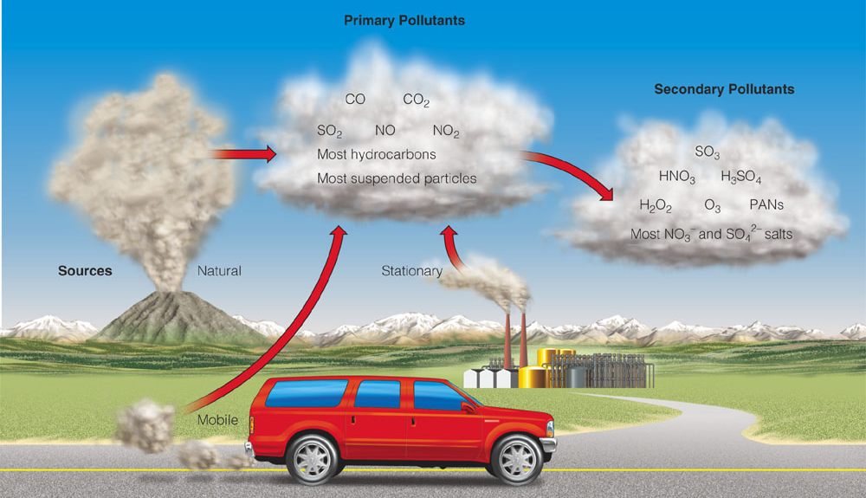
Outdoor Air Pollution
Primary - Released directly from planet’s surface. Dust, smoke particles, Nitrogen, Carbon etc.
Secondary - Formed when primary pollutants react or combine with one another, or basic elements.

Slide 9
Types of Major Air Pollutants
Carbon oxides (CO, CO₂)
Nitrogen oxides and nitric acid
(NO, NO₂, HNO₃)
Sulfur dioxide and sulfuric acid
(SO₂, H₂SO₄₎
Particulates (SPM)
Ozone (O₃)
Volatile organic compounds (VOCs)

Slide 10
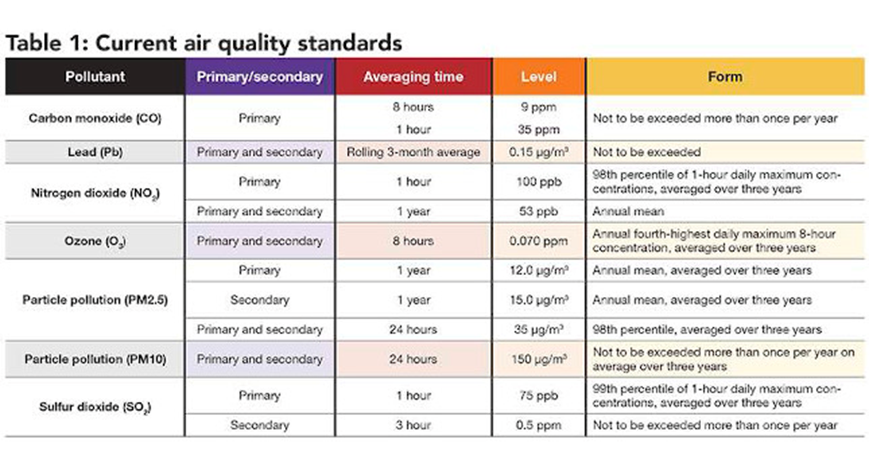
EPA Standards

Slide 11
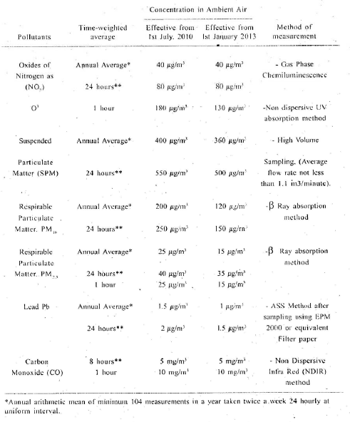
PEQS

Slide 12
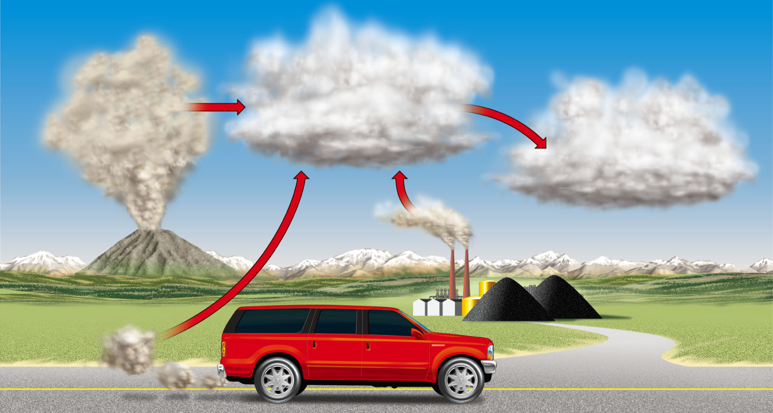
Primary Pollutants
CO
CO₂
Secondary Pollutants
SO₂
NO
NO₂
Most hydrocarbons
SO₃
Most suspended particles
HNO₃
H₂SO₄
H₂O₂
O₃
PANs
Most NO₃– and SO₄^{2–} salts
Sources
Natural
Stationary
Mobile
Fig. 15-3, p. 371
Notes:
Figure 15.3: Sources and types of air pollutants. Human inputs of air pollutants may come from mobile sources (such as cars) and stationary sources (such as industrial and power plants). Some primary air pollutants may react with one another or with other chemicals in the air to form secondary air pollutants.

Slide 13
Pollutants
Carbon Monoxide
Sulphur Dioxide
Produced by burning of organic material (coal, gas, wood, trash, etc.)
Automobiles biggest source (80%)
Cigarette smoke another major source
Toxic because binds to hemoglobin, reduces oxygen in blood
Not a persistent pollutant, combines with oxygen to form CO2
Most communities now meet EPA standards, but rush hour traffic can produce high CO levels
Produced by burning sulfur containing fossil fuels (coal, oil)
Coal-burning power plants major source
Reacts in atmosphere to produce acids
One of the major components of acid rain
When inhaled, can be very corrosive to lung tissue

Slide 14
Pollutants
Nitrogen Oxides
Hydro carbons
Produced from burning of fossil fuels
Contributes to acid rain, smog
Automobile engine main source
New engine technology has helped reduce, but many more cars
Hydrocarbons - organic compounds with hydrogen, carbon
From incomplete burning or evaporated from fuel supplies
Major source is automobiles, but some from industry
Contribute to smog
Improvements in engine design have helped reduce

Slide 15
Particulate Matter
Particulates - small pieces of solid materials and liquid droplets (2.5 mm and 10 mm)
Examples: ash from fires, asbestos from brakes and insulation, dust
Easily noticed: e.g. smokestacks
Can accumulate in lungs and interfere with the ability of lungs to exchange gases.
Some particulates are known carcinogens
Those working in dusty conditions at highest risk (e.g., miners)

Slide 16
Particulate Matter Types
Coarse particles PM 10
PM10 is defined as all particles with an aerodynamic diameter of 10 μm or smaller. Some common examples of PM10 are:
Mold spores
Bacteria
Dust
Smoke
Airborne viral particles
Fine Particles (PM2.5)
PM2.5 is a grouping of particles with an aerodynamic diameter of 2.5 μm or less, capable of penetrating deep into our lungs and even entering our bloodstream.
Fine particles can come from natural or human-made sources, like:
Vehicle exhaust
Wildfires
Power plant emissions
Other combustion activities

Slide 17
Particulate Matter Types
Ultra Fine Particles
PM0.1 is even smaller than fine dust, with an aerodynamic of 0.1 μm or smaller, and originates from similar sources as PM2.5.

Slide 18
Major Air Pollutants: Problems
Sulfur dioxide - acid rain, health damage, visibility reduction
Nitrogen oxides - acid rain, eutrophication, growth of weedy species
Carbon monoxide - inhibited respiration
Lead and mercury - neurological damage
Chlorofluorocarbons - ozone depletion
Volatile organic compounds – (isoprenes, terpenes, methane, & benzene, chloroform, etc) oxidized to CO, CO2 in the atmosphere; carcinogens

Slide 19
Air Pollution Control
“Dilution is the solution to pollution”
Particulate removal -air filters/ESP
Sulfur removal -scrubbers
Nitrogen oxide reduction -catalytic converters
Hydrocarbon controls -afterburners

Slide 20
Secondary Air Pollutants
Ozone (O3)
PANs (Peroxyacetyl nitrate)
Aldehydes
all three formed by interaction between NOx and VOCs.
Note: - Ozone is a pollutant in the troposphere, but natural and beneficial in the stratosphere

Slide 21
Secondary Air Pollutants
Pollutants that are formed in the lower atmosphere by chemical reactions. The two examples are ozone and secondary organic aerosol (haze).
Secondary pollutants are harder to control because they have different ways of synthesizing, and the formation are not well understood. They form naturally in the environment and cause problems like photochemical smog.

Slide 22
Industrial Smog
Burning coal
Sulfur dioxide, sulfuric acid, suspended particles
Developed versus developing countries
Air pollution control in the U.S. and Europe
China, India, Ukraine

Slide 23
Photochemical Smog
Photochemical reactions
Photochemical smog
Brown-air smog
Sources
Health effects
Urban areas

Slide 24
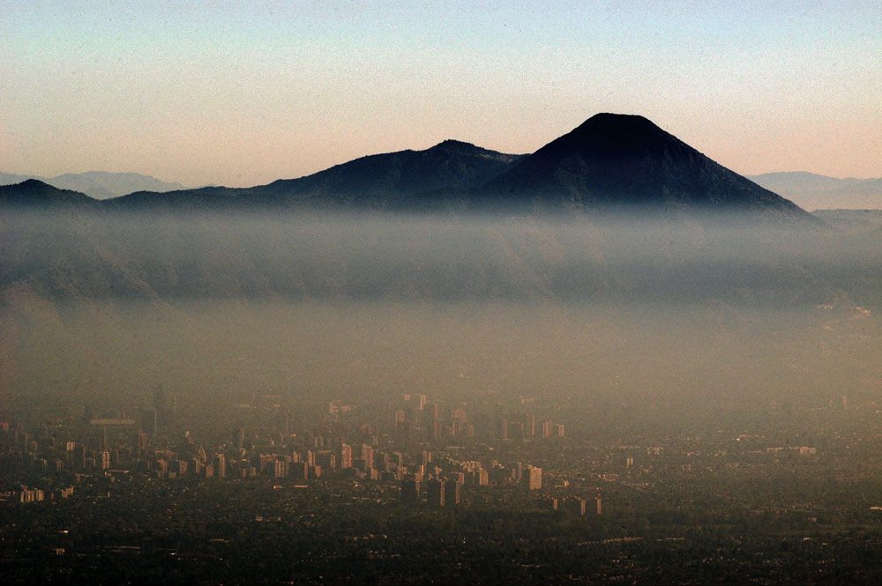
Fig. 15-4, p. 373

Slide 25
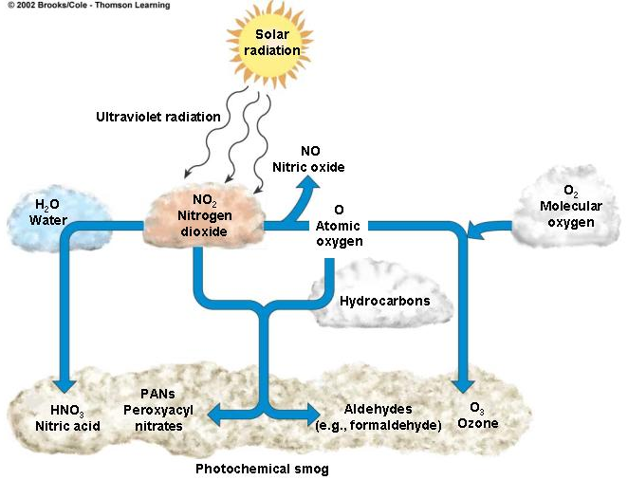
Photochemical Smog
Some primary pollutants react under the influence of sunlight (photochemical reaction), including NO_{x}, O₃, PANs..

Slide 26
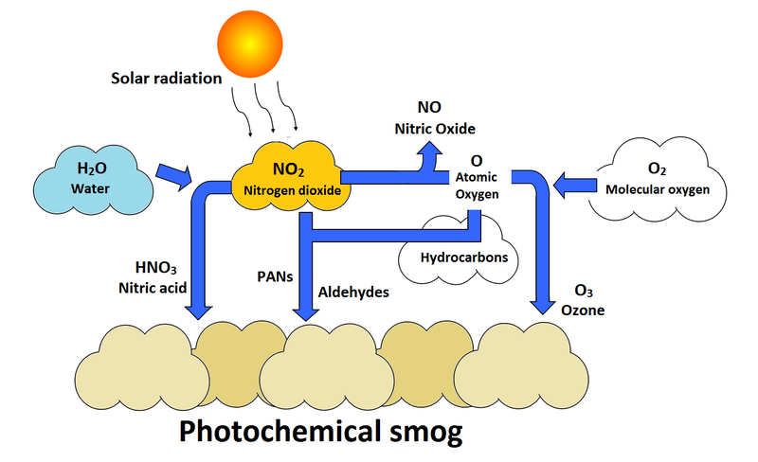

Slide 27
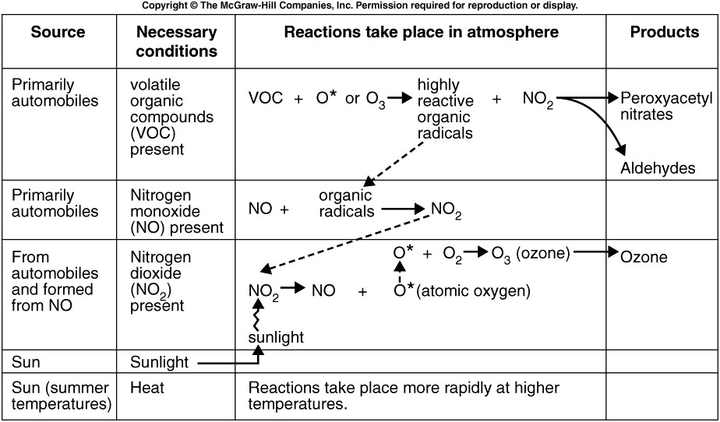

Slide 28
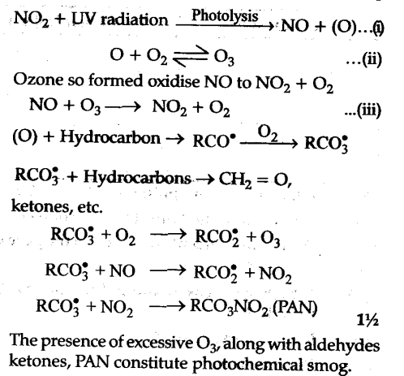
Photochemical Smog Formation

Slide 29
Indoor Air Pollution
Developing countries
Indoor cooking and heating
Often higher concentration in buildings and cars
Most time is spent indoors or in cars
EPA – top cancer risk

Slide 30
Major Indoor Air Pollutants
Tobacco smoke
Formaldehyde
Radioactive radon-222 gas
Very small particles

Slide 31
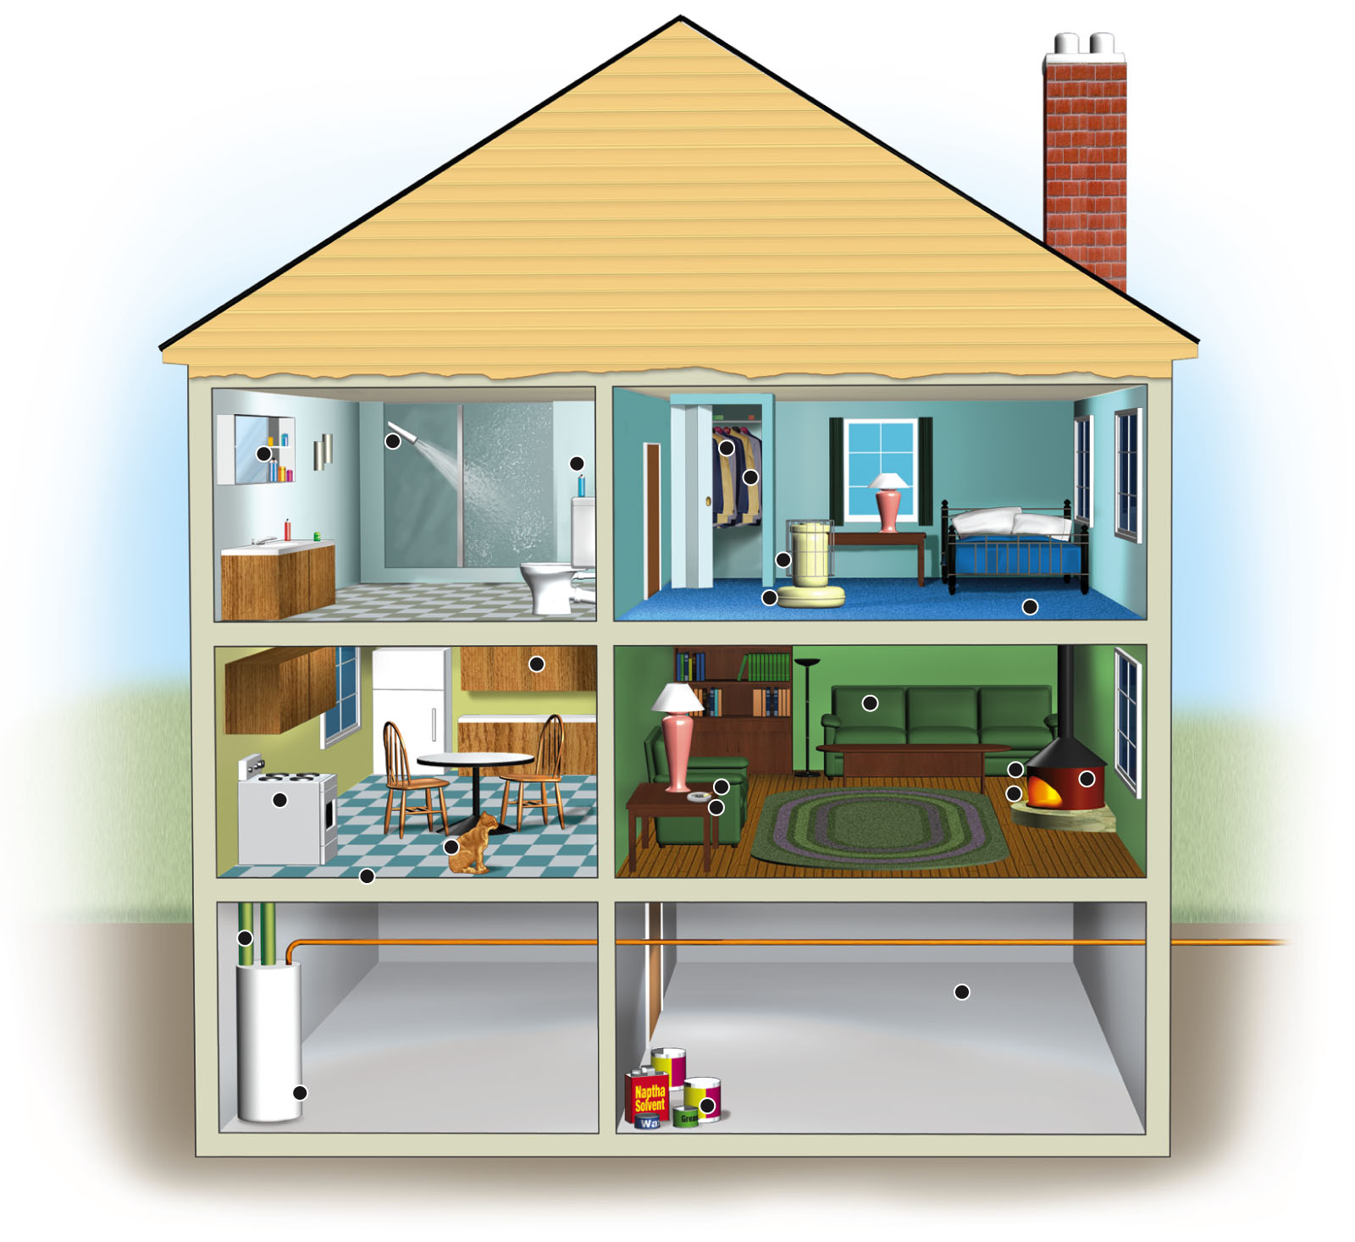
Chloroform
Source: Chlorine-treated water in
hot showers
Possible threat: Cancer
Para-dichlorobenzene
Source: Air fresheners,
mothball crystals
Threat: Cancer
Tetrachloroethylene
Source: Dry-cleaning
fluid fumes on clothes
Threat: Nerve disorders,
damage to liver and
kidneys, possible cancer
Formaldehyde
Source: Furniture stuffing,
paneling, particleboard,
foam insulation
Threat: Irritation of eyes,
throat, skin, and lungs;
nausea; dizziness
1,1,1-Trichloroethane
Source: Aerosol sprays
Threat: Dizziness,
irregular breathing
Styrene
Source: Carpets,
plastic products
Threat: Kidney and
liver damage
Nitrogen oxides
Source: Unvented gas
stoves and kerosene
heaters, woodstoves
Threat: Irritated lungs,
children's colds,
headaches
Benzo-α-pyrene
Source: Tobacco smoke,
woodstoves
Threat: Lung cancer
Particulates
Source: Pollen, pet
dander, dust mites,
cooking smoke particles
Threat: Irritated lungs,
asthma attacks, itchy
eyes, runny nose,
lung disease
Radon-222
Source: Radioactive soil
and rock surrounding
foundation, water supply
Threat: Lung cancer
Tobacco smoke
Source: Cigarettes
Threat: Lung cancer, respiratory
ailments, heart disease
Asbestos
Source: Pipe insulation, vinyl
ceiling and floor tiles
Threat: Lung disease, lung cancer
Carbon monoxide
Source: Faulty furnaces,
unvented gas stoves and
kerosene heaters,
woodstoves
Threat: Headaches,
drowsiness, irregular
heartbeat, death
Methylene chloride
Source: Paint strippers and thinners
Threat: Nerve disorders, diabetes
Stepped Art
Fig. 15-8, p. 377
Notes:
Figure 15.8: Some important indoor air pollutants (Concept 15-1B).
Question: Which of these pollutants are you exposed to?
(Data from U.S. Environmental Protection Agency)

Slide 32
Natural Factors That Increase Air Pollution
Urban buildings
Hills and mountains
High temperatures
VOC emissions from certain trees and plants
Grasshopper effect
Temperature inversions

Slide 33
Natural Factors That Reduce Air Pollution
Particles heavier than air
Rain and snow
Salty sea spray from oceans
Winds
Chemical reactions

Slide 34
Air Pollution and the Human Respiratory System
Natural protective system
Lung cancer, chronic bronchitis, emphysema, asthma
Premature deaths
Air pollution kills 2.4 million people prematurely every year

Slide 35
Acid Deposition
Sulfur dioxides and nitrogen oxides
Wet and dry deposition
Acid rain
Regional air pollution
Midwest coal-burning power plants
Prevailing winds

Slide 36
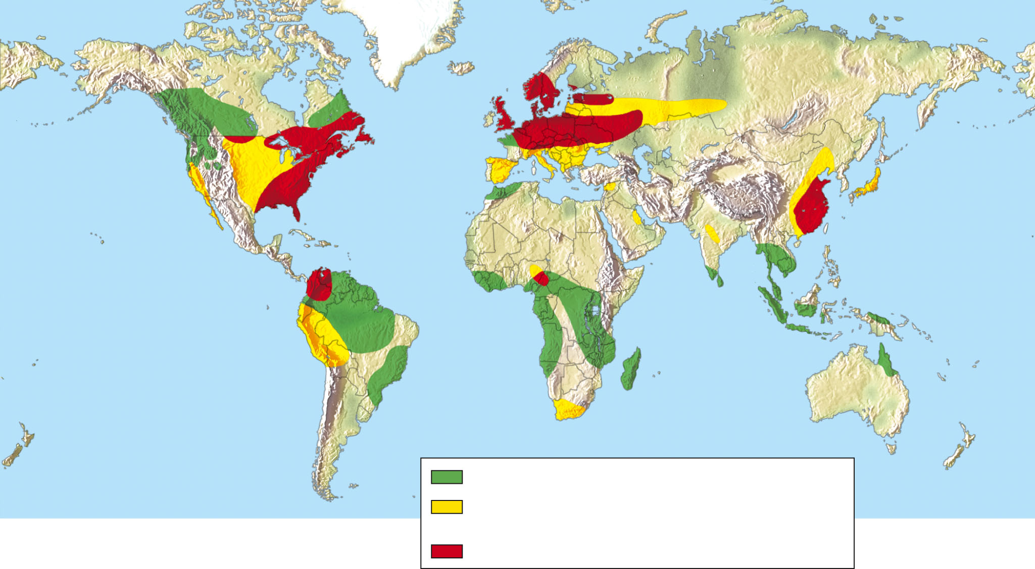
Potential problem areas because of sensitive soils
Potential problem areas because of air pollution:
emissions leading to acid deposition
Current problem areas (including lakes and rivers)
Fig. 15-6, p. 375
Notes:
Figure 15.6: Regions where acid deposition is now a problem and regions with the potential to develop this problem.
Such regions have large inputs of air pollution (mostly from power plants, industrial plants, and ore smelters) or are
sensitive areas with soils and bedrock that cannot neutralize (buffer) inputs of acidic compounds. Question: Do you
live in or near an area that is affected by acid deposition or an area that is likely to be affected by acid deposition in
the future? (Data from World Resources Institute and U.S. Environmental Protection Agency, 2007)

